Slide 1
Information Processing and Retrieval Project
Gonçalo Teixeira, up201806562
Pedro Pinto, up201806251
Pedro Azevedo, up201806728

Slide 2
System Tool Improvement
Main improvements made to our system tool:
Extra information from a different source by our web application directly;
Filters to be used in the main fields to easily improve the results.
Some experiments were made regarding solr filters but no diferences worth mentioning happened to the tool performance (maybe tests used lacked complexity).

Slide 3
Enhancing UX
We decided to upgrade user experience by developing a web application and adding some extra information features to the already built system:
Using React + ExpressJS + Solr
Adding (another) external data source (TMDb) to fetch multimedia data and extra information (posters, profile pictures, ...)
This application allows for easy search tasks with filters and custom sorting methods to enhance user experience and make a real-world case scenario for this search system.

Slide 4
Web Application
Built with React + ExpressJS + Solr

Slide 5
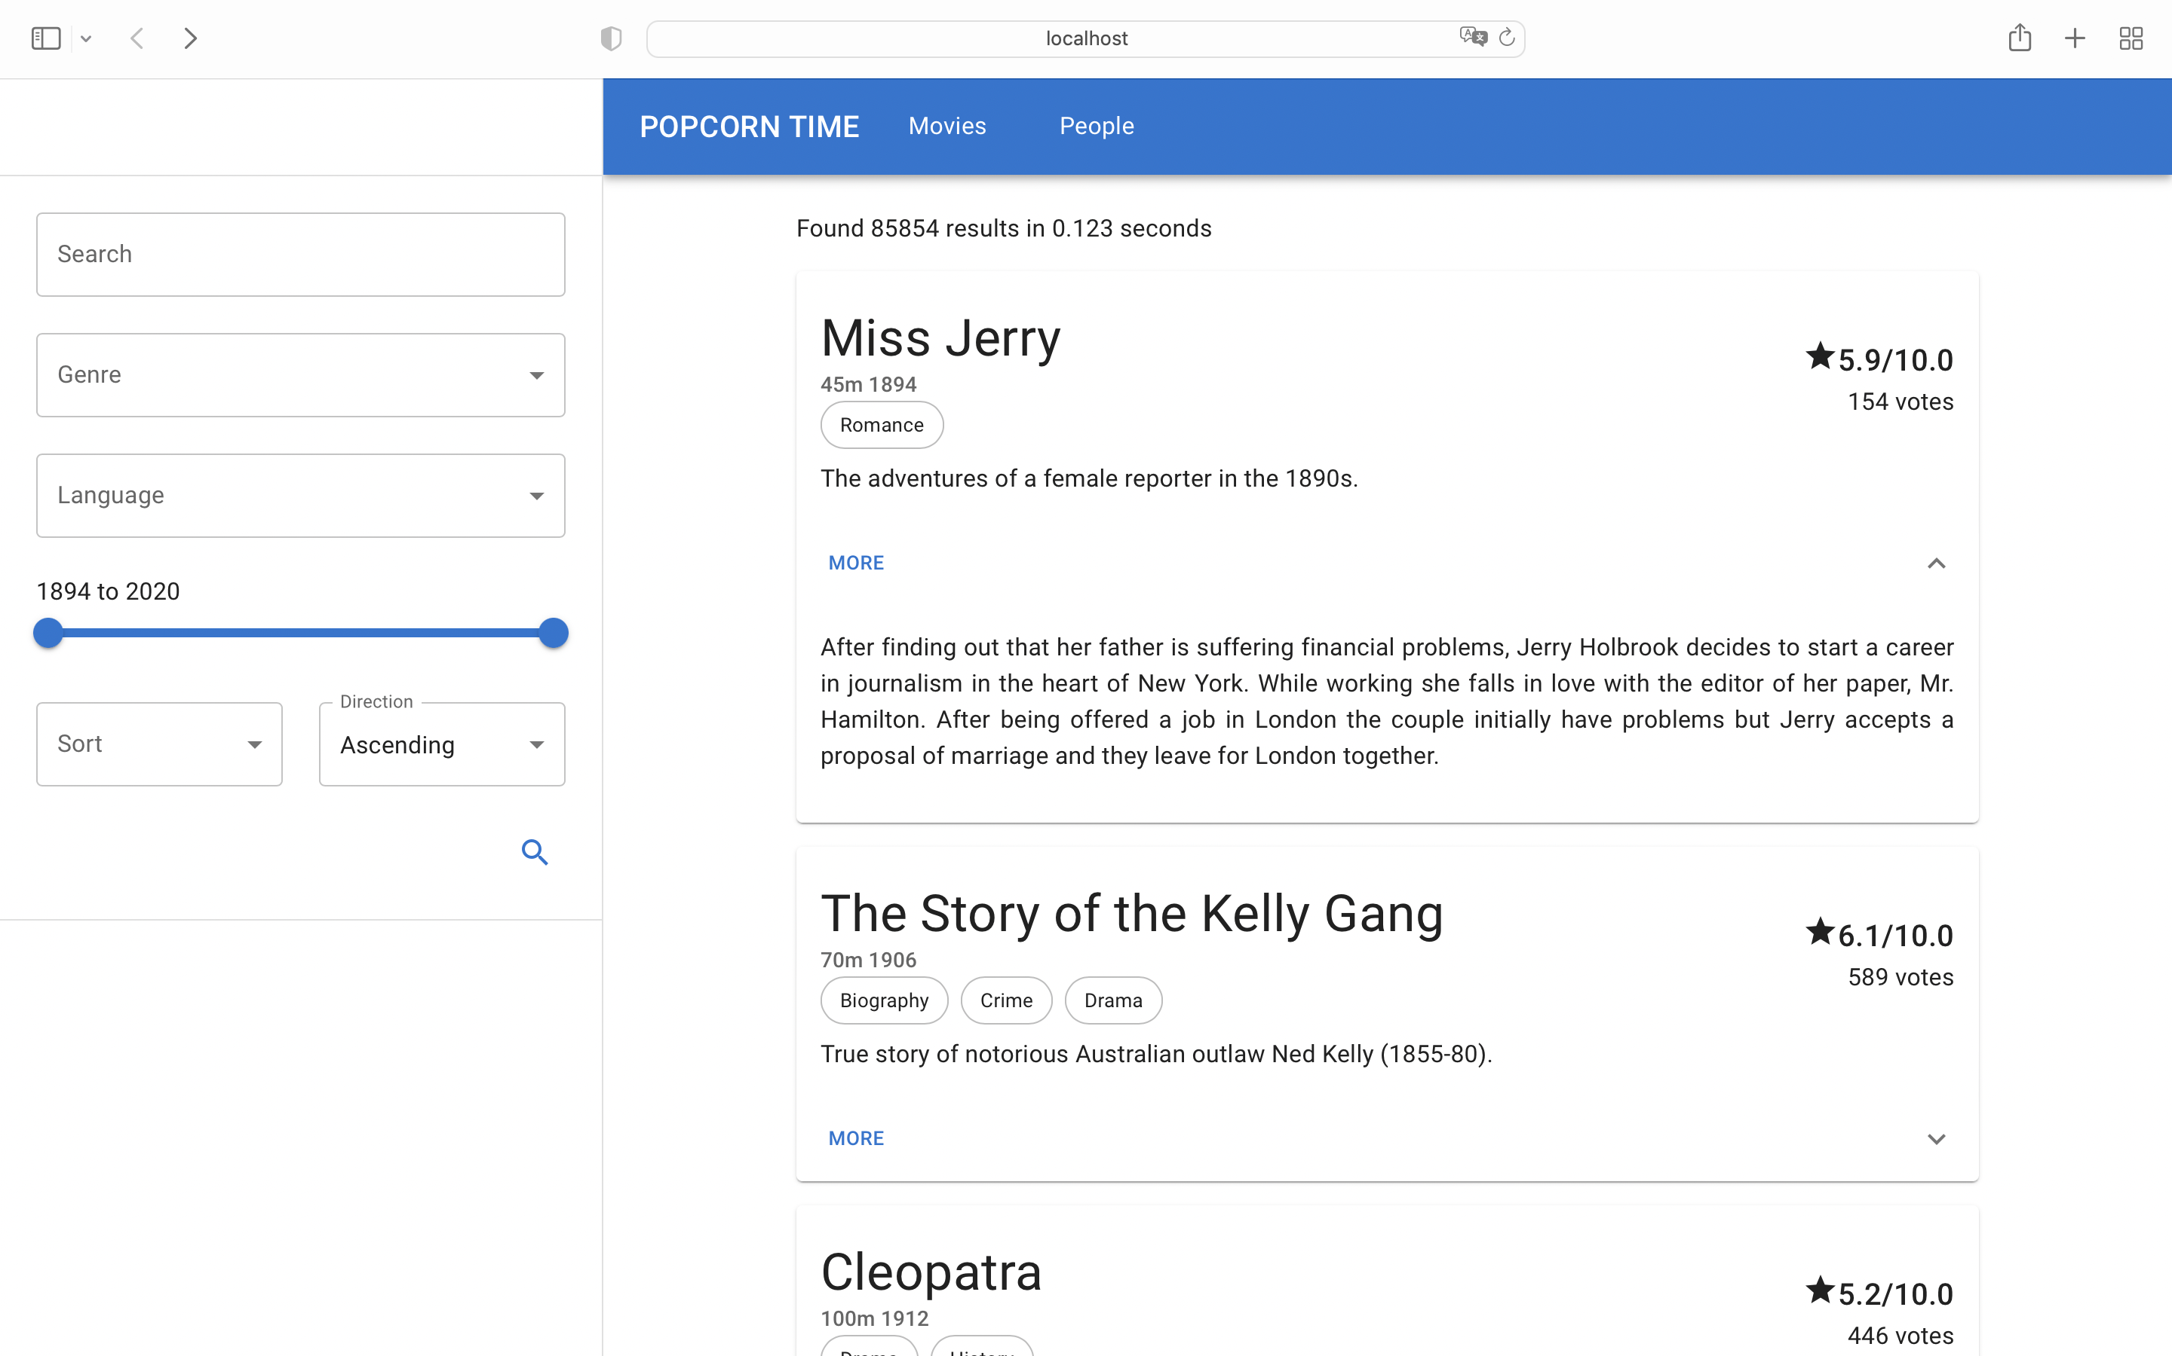

Slide 6
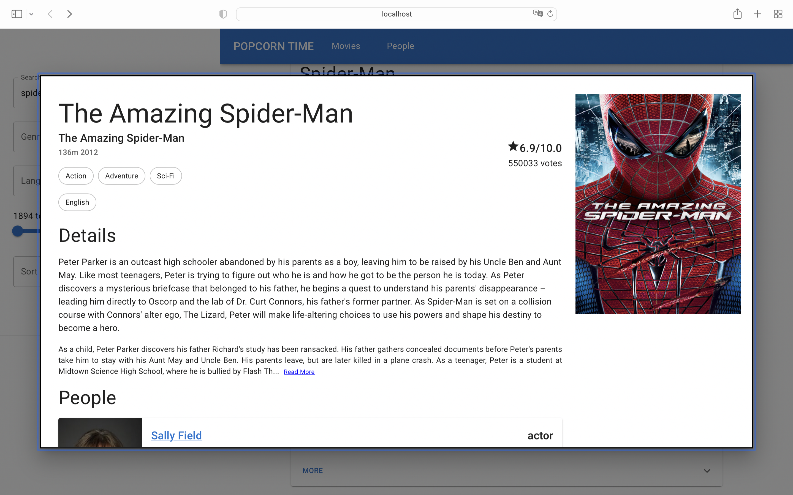

Slide 7
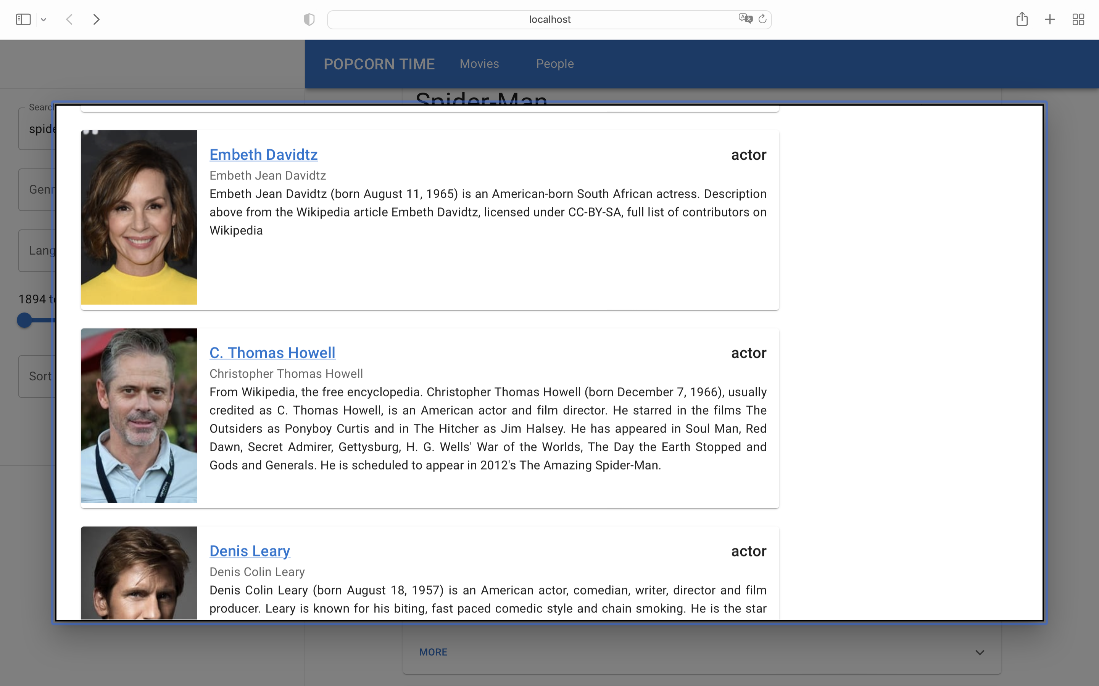

Slide 8
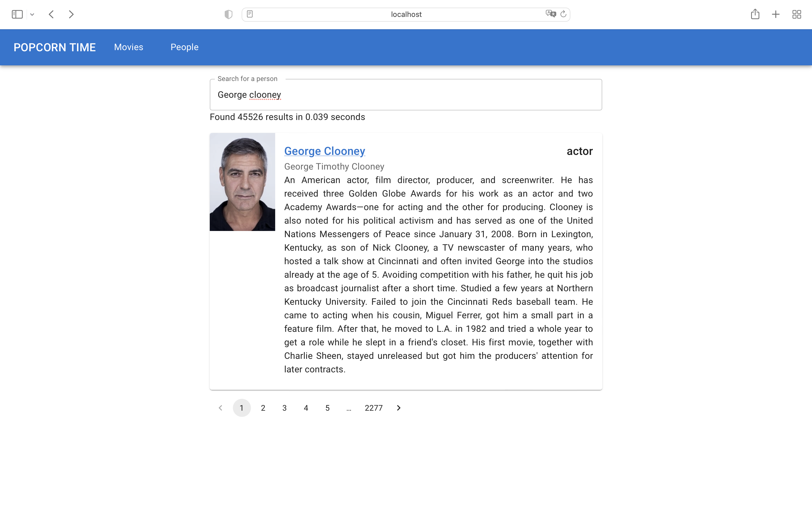

Slide 9
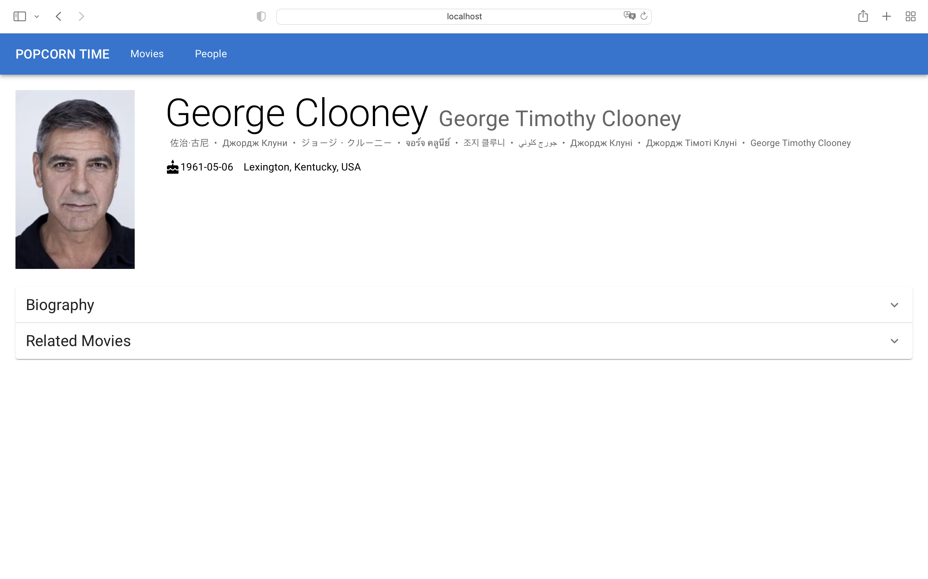

Slide 10
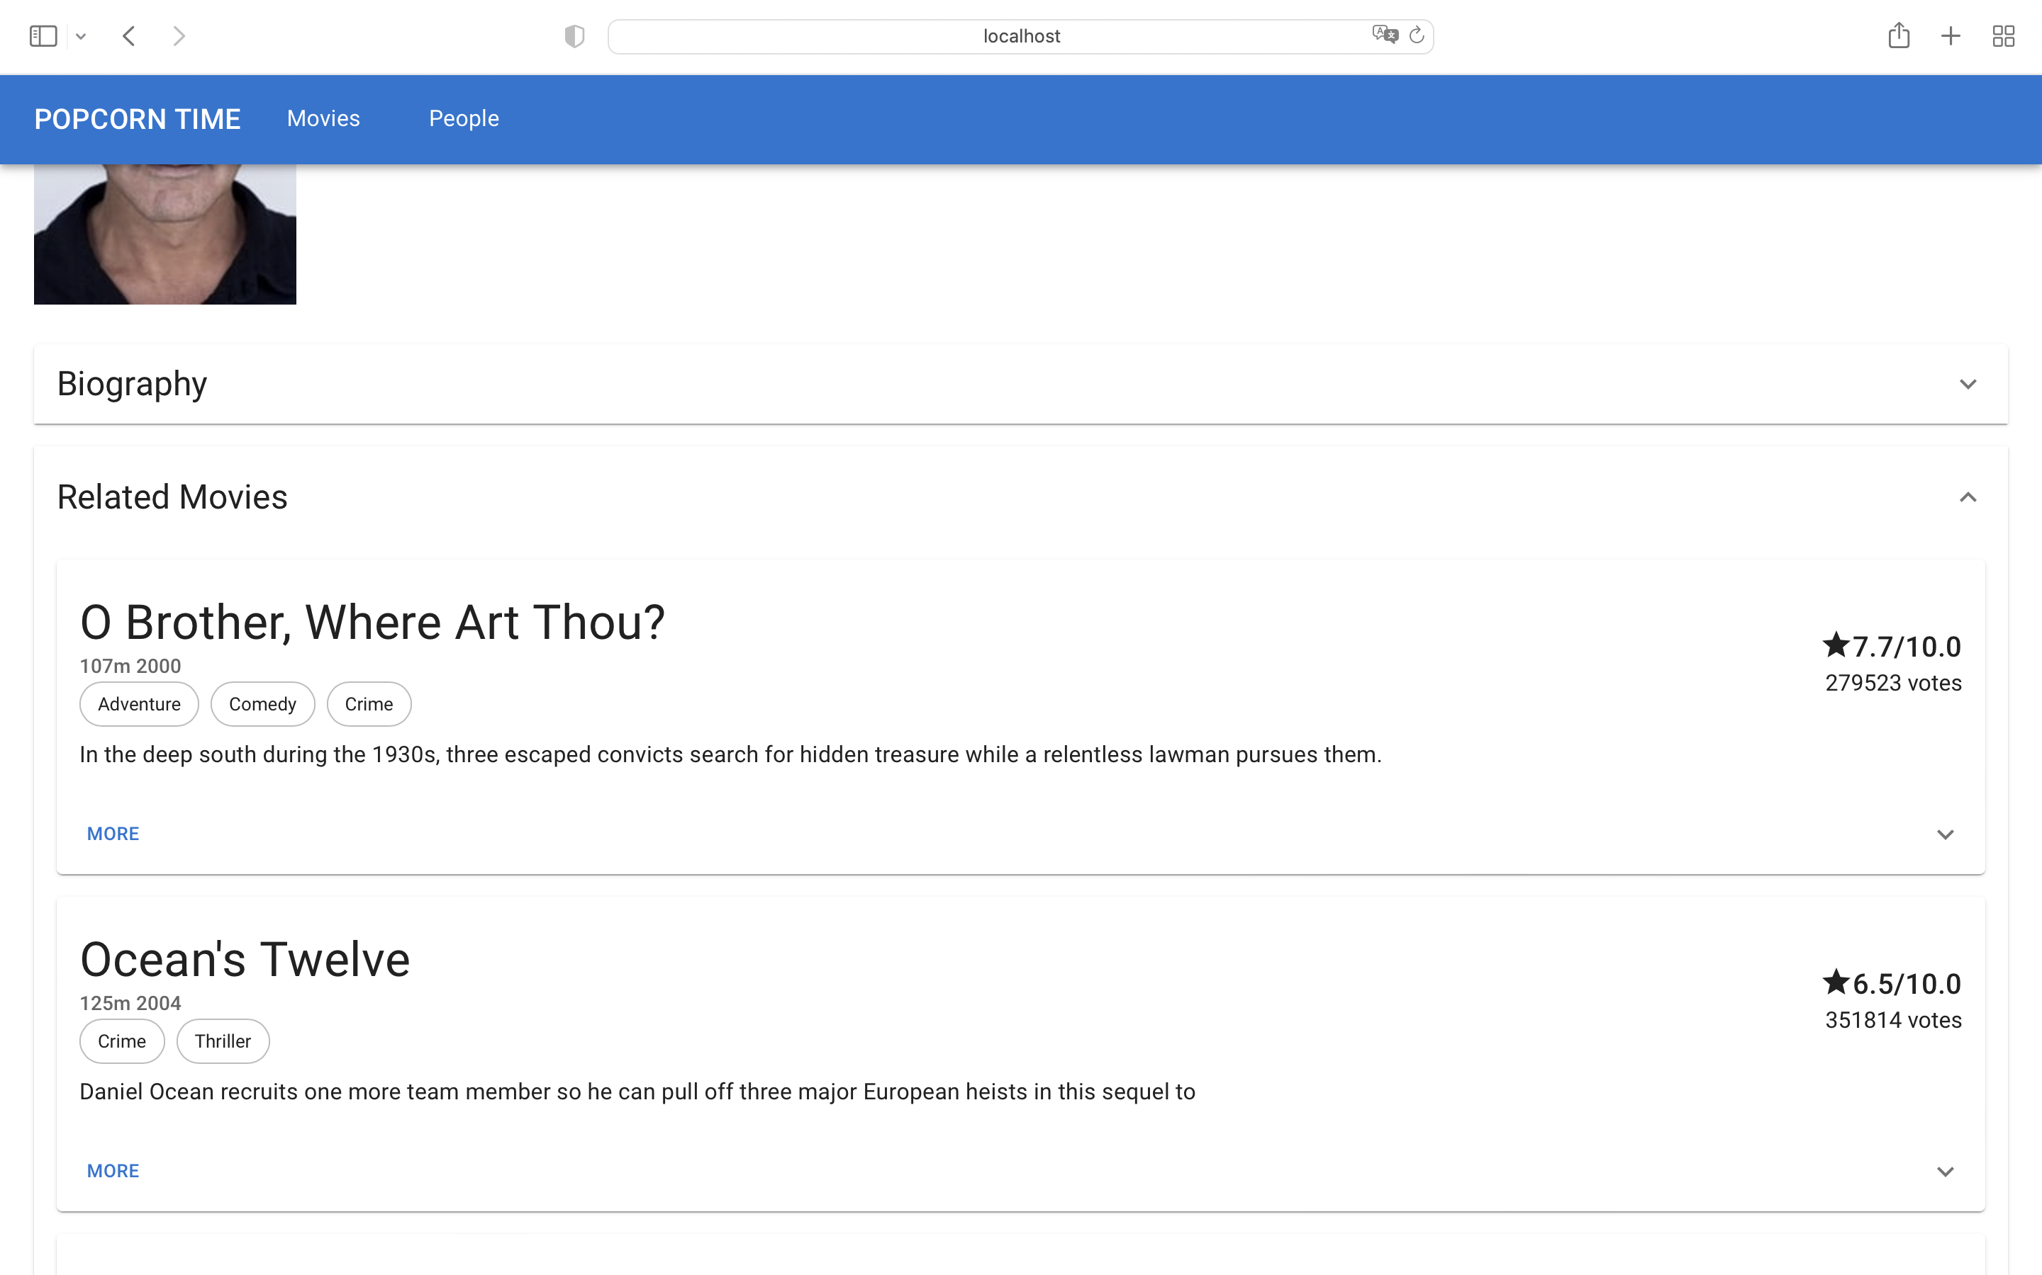

Slide 11
Conclusion
The indexing process was done just by exploring the Solr documentation
Regarding evaluation, some improvements were made not just to the retrieval tool, but also to our analysis of it.
The web application greatly improves the usability of our tool, making the information easily accessable and understandable.

